Slide 1
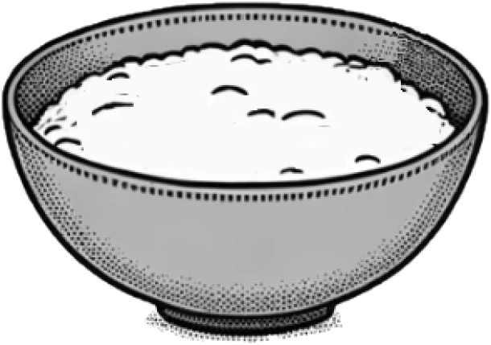
Multiplicative relationships in context
Task A: Multiplicative relationships in context
1) Fill in the table knowing the following multiplicative relationships:
a) Number of eggs × 75 = Sugar
b) Flour is twice as many grams as butter
c) Butter × 1.5 = Sugar
Butter (g) | Flour (g) | Eggs | Sugar (g)
100 | 200 | 2 | 150
400 | 800 | 8 | 600
500 | 1000 | 10 | 750
2) Most bread doughs start with flour and water. To make chapati, for every two cups of flour, you add one cup of water. To make pizza base, for every three cups of flour, you add two cups of water.
In each bowl, is it chapati dough, pizza base dough, or neither?
Dough | Cups of flour | Cups of water
1 chapati | 2 | 1
Dough | Cups of flour | Cups of water
1 pizza | 3 | 2
4.5 chaptis | 9 | 4.5
3 pizzas | 9 | 6
6 chaptis | 12 | 6
4 pizzas | 12 | 8
9 chaptis | 18 | 9
6 pizzas | 18 | 12
12 chaptis | 24 | 12
8 pizzas | 24 | 16
a)
d)
9 cups of flour
6 cups of water
12 cups of flour
8 cups of water
12 cups of flour
6 cups of water
Pizza
b)
e)
Pizza
c)
f)
Chapati
18 cups of flour
12 cups of water
24 cups of flour
12 cups of water
24 cups of flour
18 cups of water
Pizza
Chapati
Neither

Slide 2

Multiplicative relationships in context
Task A: Multiplicative relationships in context
3) To make the perfect meringue, for every three eggs you add 150 g sugar. What is the minimum needed to add to each mixture below to make the meringue perfect?
a)
b)
c)
200 g sugar
6 eggs
450 g sugar
7 eggs
400 g sugar
9 eggs
Recipe ×2:
300 g sugar
6 eggs
Recipe ×3:
450 g sugar
9 eggs
Recipe ×3:
450 g sugar
9 eggs
Add 100g sugar
Add 2 eggs
Add 50 g sugar
d)
e)
500 g sugar
9 eggs
500 g sugar
10 eggs
Another solution for d)
No change. It is perfect!
Recipe ×4:
600 g sugar
12 eggs
Sugar ÷ 50 = eggs
500 g sugar
10 eggs
Add 200 g sugar
Add 3 eggs
Add 1 egg

Slide 3




Multiplicative relationships in context
Task B: Converting money
1) Fill in the currency conversion table using the following ratio:
Euros (€) | USA dollars ($)
1 | 1.08
11 | 11.88
20 | 21.60
0.5 | 0.54
50 | 54
150 | 162
2) A group of three friends are going on holiday. They all exchange some pounds for euros.
I got €120 for £100
I got €30 for £20
I got €90 for £60
Sofia
Laura
Sam
Laura and Sam got the best deal
a) Who got the best deal?
b) Andeep decided to come along too and exchanged €110 for £100. Whose deal was it most similar to?
Sofia
Laura
Sam
Pounds (£) | Euros (€)
100 | 120
Pounds (£) | Euros (€)
20 | 30
Pounds (£) | Euros (€)
60 | 90
×1.2
×1.5
×1.5
120 ÷ 100 = 1.2
30 ÷ 20 = 1.5
90 ÷ 60 = 1.5
Pounds × 1.2 = Euros
Pounds × 1.5 = Euros
Pounds × 1.5 = Euros
110 ÷ 100 = 1.1 this is most similar to Sofia
Mathematics in Education and Industry
v2.3

